Slide 1
MY SQL
What is SQL?
SQL, which stands for Structured Query Language, is a specialized programming language used for managing and manipulating data stored in relational databases
SQL Categories ;
DQL (Data Query Language)
DML (Data Manipulation Language)
DCL (Data Control Language)
TCL (Transaction Control Language)
DDL (Data Definition Language)

Slide 2
DDL (Data Definition Language):DDL is used to define the structure of the database and its objects.
CREATE: Creates new database objects such as tables, views, indexes, etc.
ALTER: Modifies the structure of existing database objects.
DROP: Deletes database objects.
TRUNCATE: Removes all data from a table.
RENAME: Renames database objects.
DML (Data Manipulation Language):DML is used to manipulate data stored in the database.
SELECT: Retrieves data from one or more tables.
INSERT: Adds new rows of data into a table.
UPDATE: Modifies existing data in a table.
DELETE: Removes rows of data from a table.

Slide 3
DCL (Data Control Language):DCL is used to control access to data within the database.
GRANT: Provides specific privileges to database users.
REVOKE: Revokes privileges granted to database users.
TCL (Transaction Control Language):TCL is used to manage transactions within the database.
COMMIT: Makes the changes performed by the current transaction permanent.
ROLLBACK: Undoes the changes made by the current transaction.
DQL (Data Query Language):DQL is used to retrieve data from the database.
The primary command in DQL is SELECT, which is used to query the database and retrieve specific information from one or more tables.

Slide 4
SQL Commands
1. CREATE:Used to create new database objects such as tables, views, indexes, etc.
Example: CREATE TABLE employees (id INT, name VARCHAR(100), salary DECIMAL(10,2));
2. DELETE:Used to remove rows of data from a table.
Example: DELETE FROM employees WHERE id = 123;
3. DROP:Used to delete database objects like tables, views, indexes, etc.
Example: DROP TABLE employees;
4. UPDATE:Used to modify existing data in a table.
Example: UPDATE employees SET salary = 50000 WHERE id = 123;
5. RENAME:Used to rename database objects like tables, views, etc.
Example: ALTER TABLE employees RENAME TO staff;
6. SELECT:Used to retrieve data from one or more tables.
Example: SELECT * FROM employees;
7. FROM:Specifies the table(s) from which data is retrieved in a SELECT statement.
Example: SELECT * FROM employees WHERE department = 'IT';

Slide 5
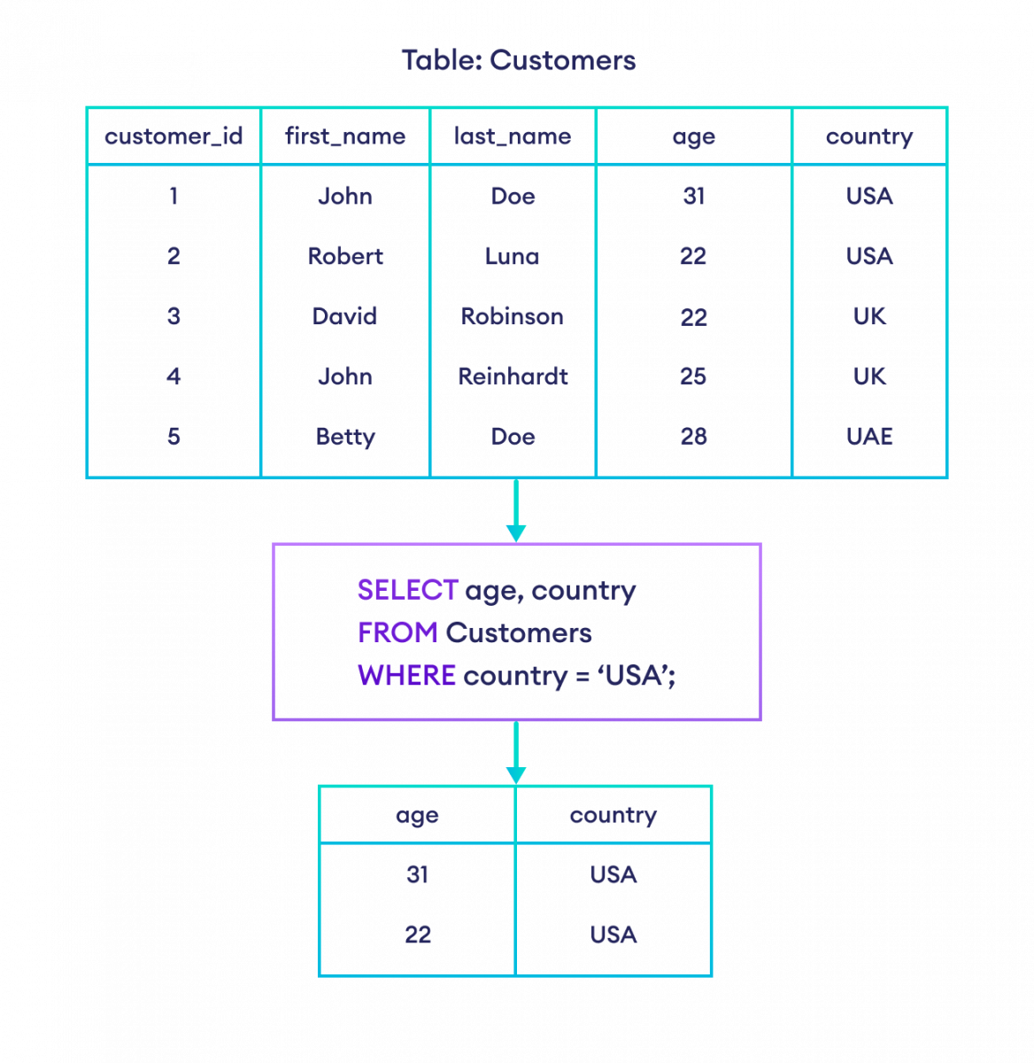
8.WHERE: The WHERE clause is used to filter rows from a result set based on a specified condition. It is used to specify a condition that must be met for a row to be included in the result set.

Slide 6
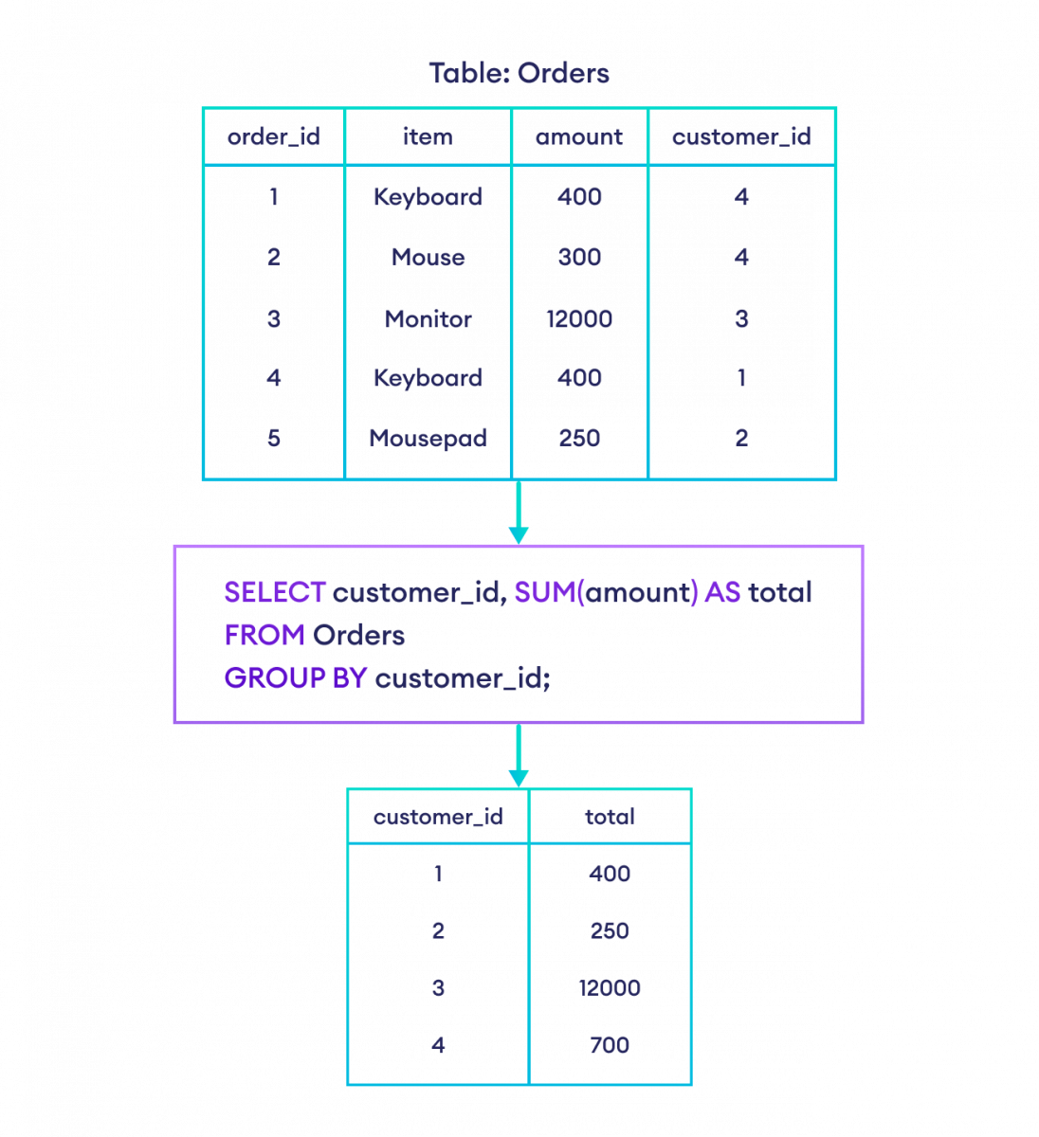
9.GROUP BY: The GROUP BY clause is used to group rows that have the same values into summary rows, like "total" or "count" for those groups. It is typically used with aggregate functions like COUNT(), SUM(), AVG(), etc.

Slide 7
10.HAVING: The HAVING clause is used in combination with the GROUP BY clause to filter groups based on a specified condition. It is similar to the WHERE clause but is used specifically for conditions on aggregated values.

Slide 8
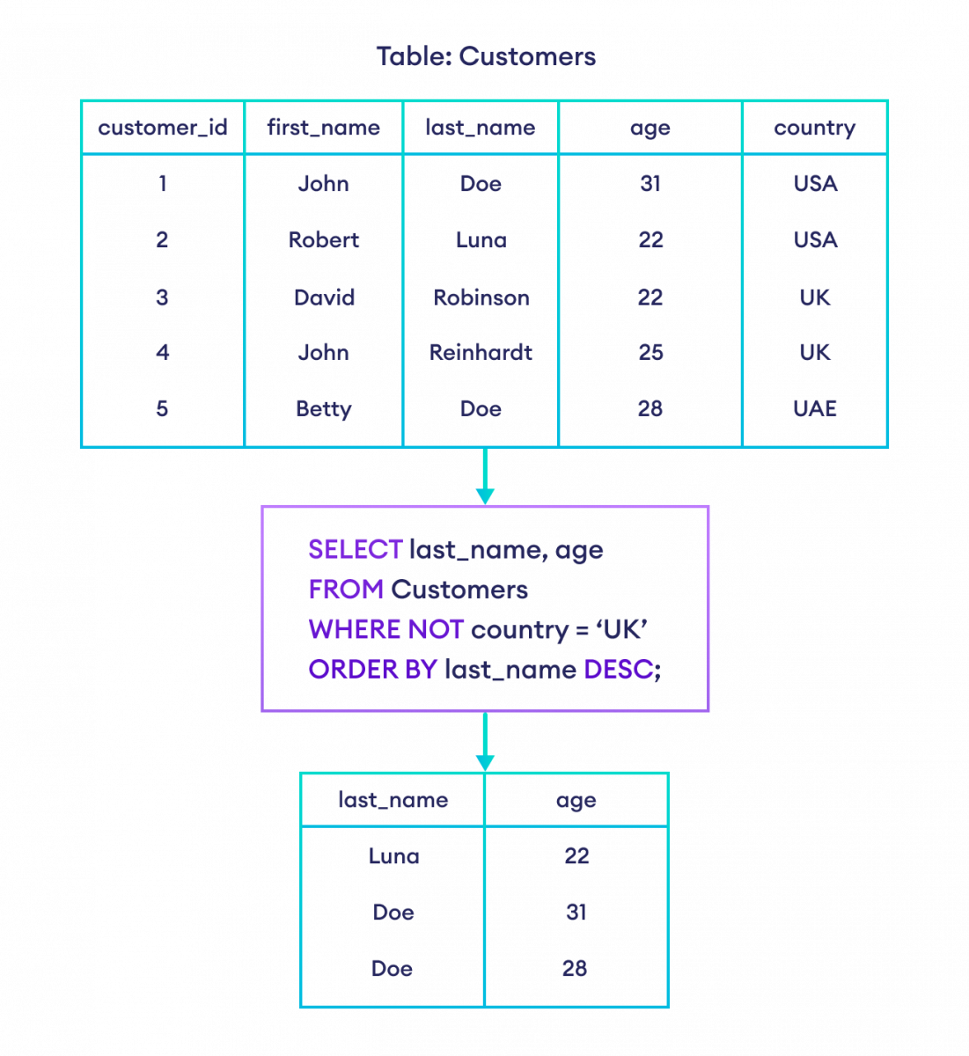
11.ORDER BY: The ORDER BY clause is used to sort the rows of a result set based on one or more columns. It allows you to specify the column(s) by which the result set should be sorted and the sort order (ascending or descending).

Slide 9
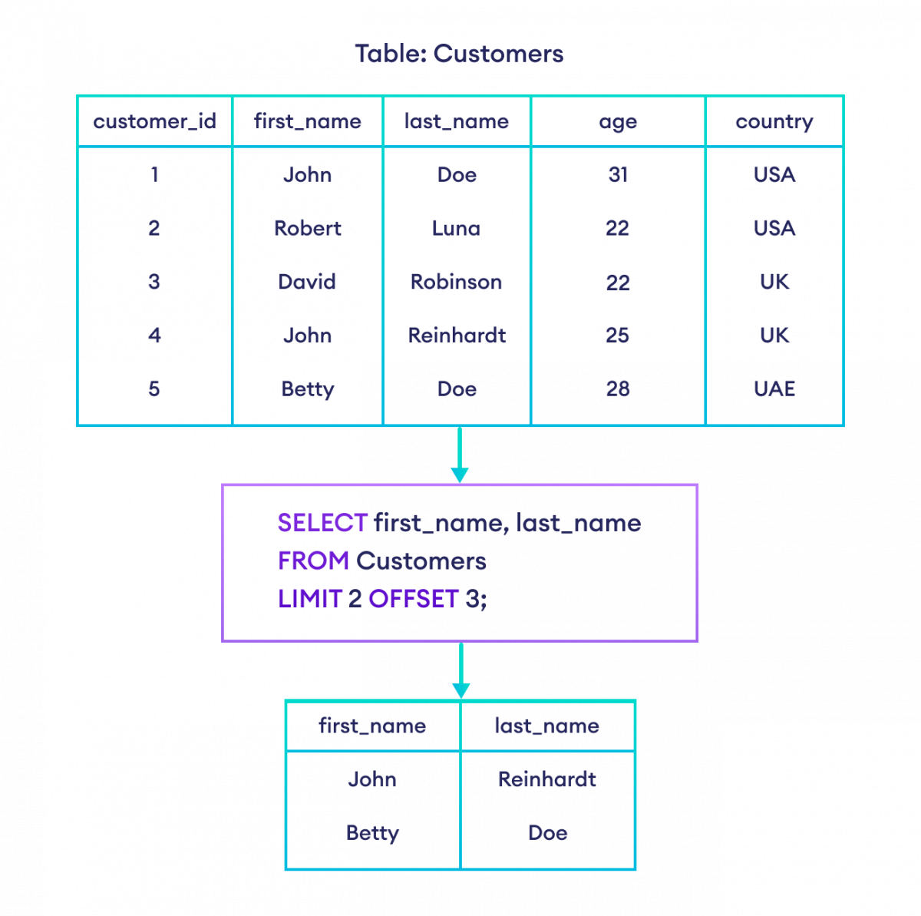
9.LIMIT:The LIMIT clause allows you to specify the maximum number of rows to be returned by the query. Additionally, you can specify an optional offset to skip a certain number of rows before returning results.

Slide 10
Database Concepts
Constraints
View
Index
Data Types

Slide 11
SQL constraints:
NOT NULL
UNIQUE
DEFAULT
PRIMARY KEY
FOREIGN KEY
CHECK

Slide 12
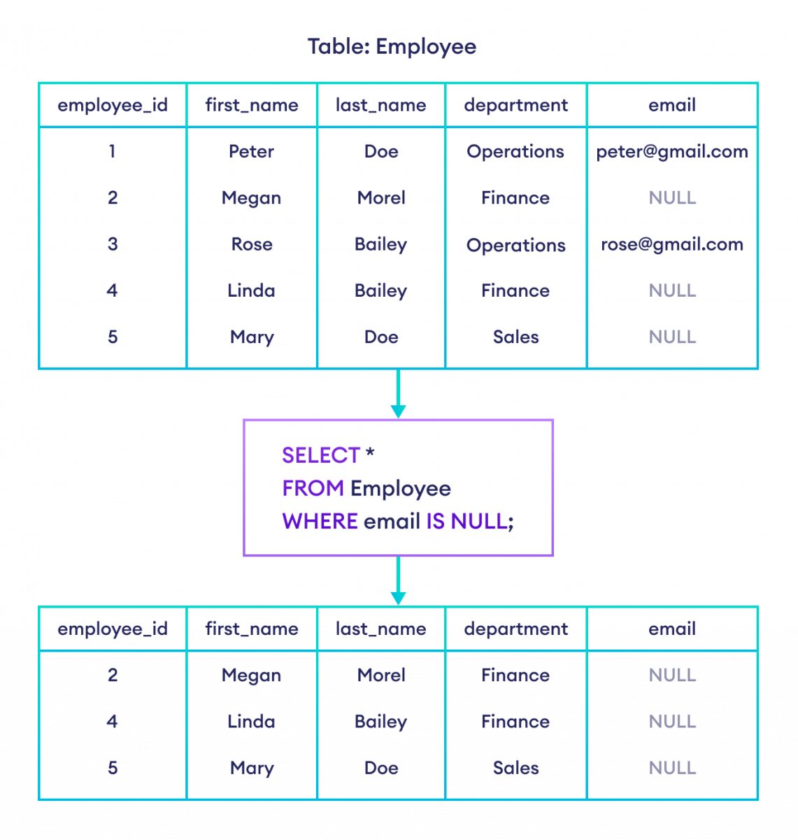
NOT NULL: This constraint ensures that a column cannot have a NULL (empty) value. It requires each value in the column to be filled.

Slide 13
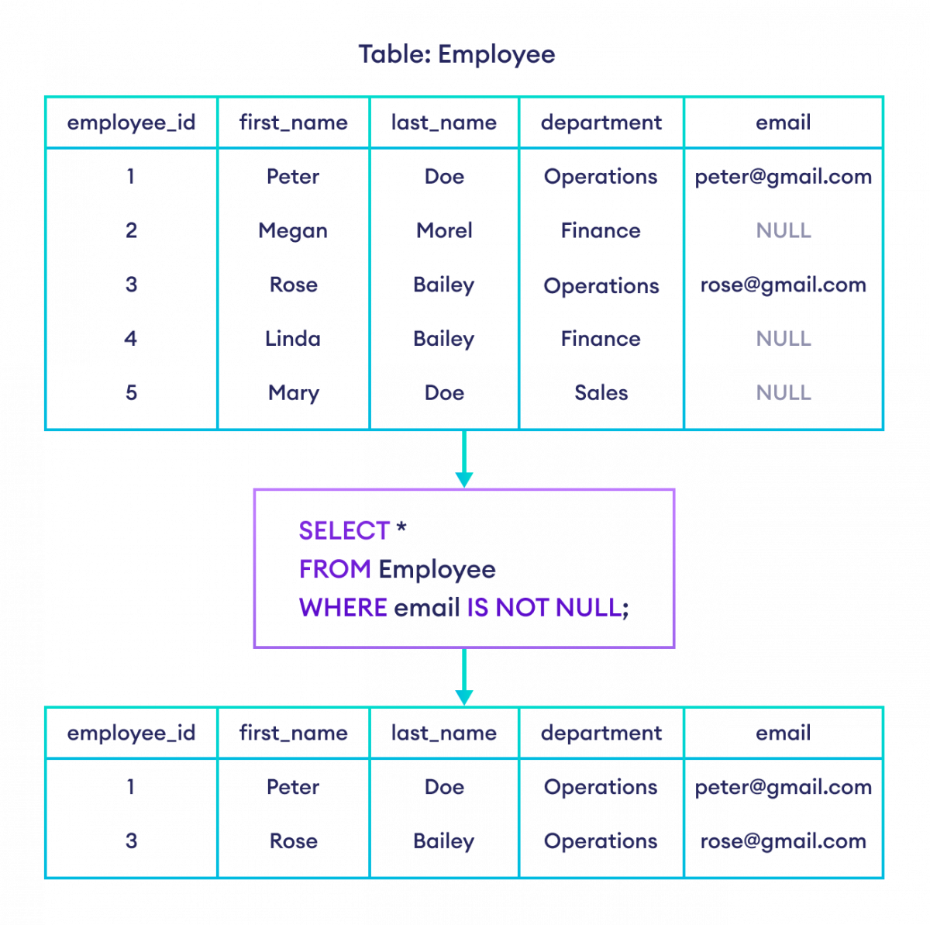
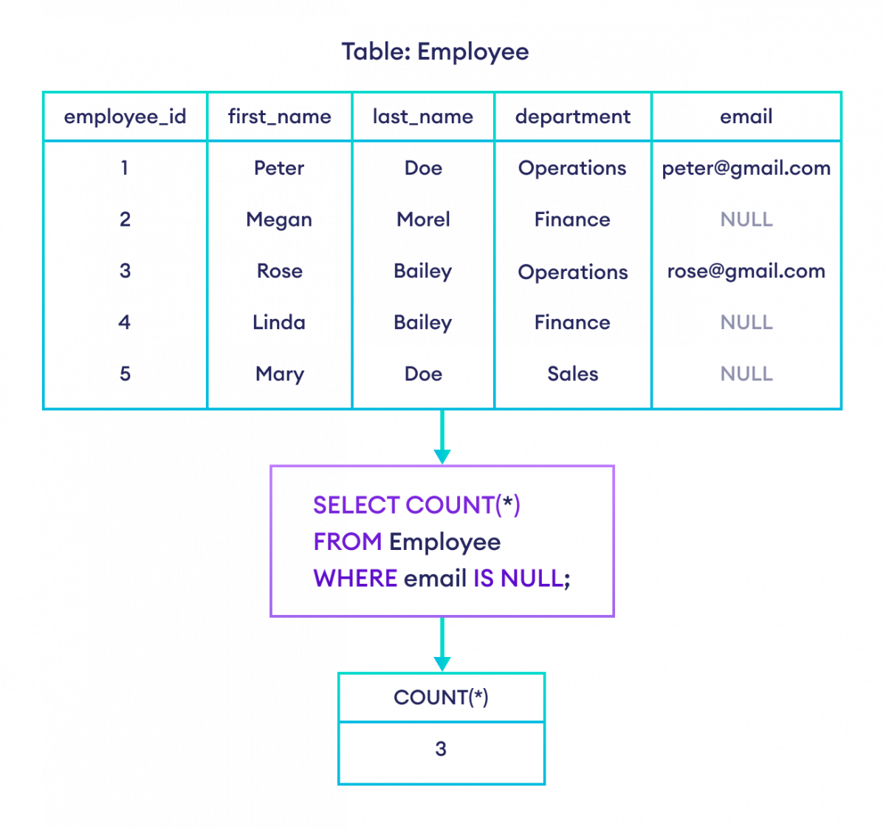

Slide 14
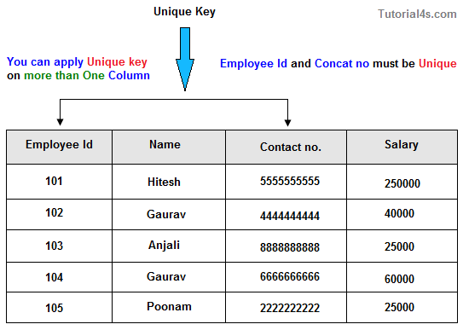
UNIQUE: This constraint ensures that all values in a column (or a combination of columns) are unique, meaning no two rows can have the same value(s) in the specified column(s).

Slide 15
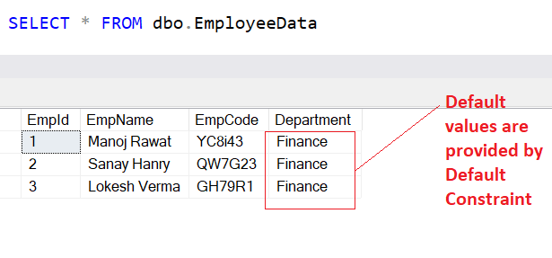
DEFAULT: This constraint allows you to specify a default value for a column, which is used when an explicit value is not provided during an INSERT operation.

Slide 16
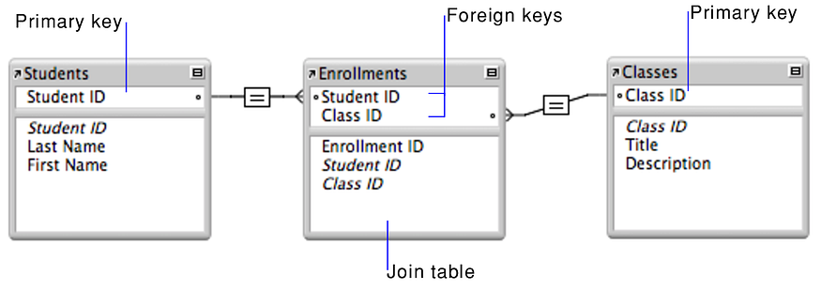
PRIMARY KEY: This constraint uniquely identifies each record in a table. It must contain unique values and cannot have NULL values. A table can have only one primary key.
FOREIGN KEY: This constraint establishes a relationship between two tables. It ensures referential integrity by requiring that the values in one table's column (the foreign key) match the values in another table's primary key or unique key.

Slide 17
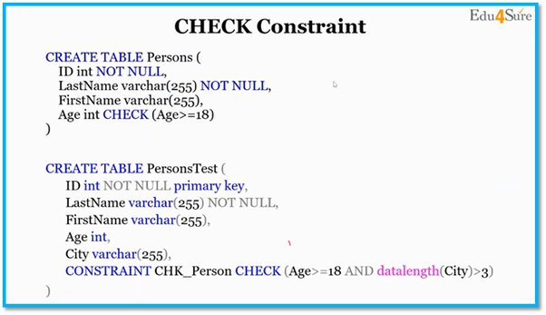
CHECK: This constraint allows you to specify a condition that must be met for the values in a column. It ensures that the data entered into a column meets a specific set of criteria.

Slide 18
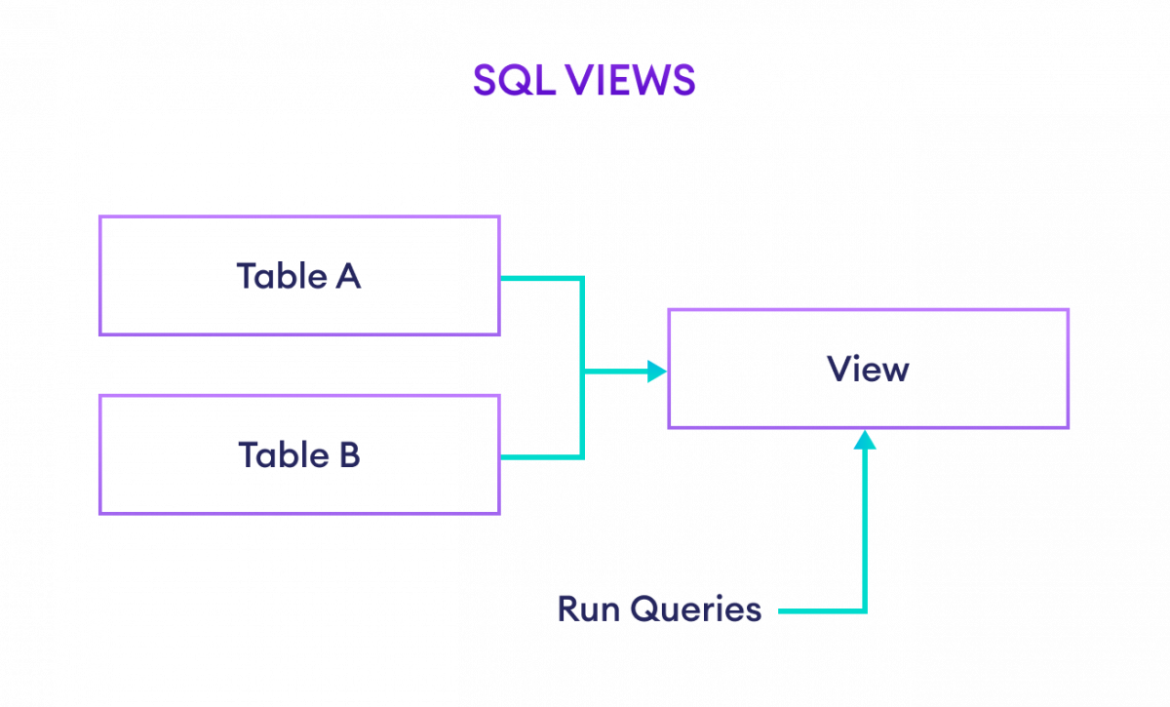
SQL views: 1.CREATE VIEW 2.UPDATING A VIEW 3.DROP VIEW
CREATE VIEW: This statement is used to create a new view in the database. A view is a virtual table that displays data retrieved from one or more underlying tables or views. The syntax typically includes the SELECT query that defines the data displayed by the view.
Eg.SELECT *FROM us_customers;

Slide 19
UPDATING A VIEW: This statement allows you to create a new view or modify an existing one. If the view already exists, it will be replaced with the new definition provided. This is helpful for updating the definition of a view without having to explicitly drop and recreate it.
Eg. CREATE OR REPLACE VIEW us_customers AS
SELECT *FROM Customers
WHERE Country = 'USA’;
DROP VIEW: This statement is used to delete a view from the database. Once a view is dropped, it no longer exists in the database, and any queries or references to the view will result in an error.
Eg. DROP VIEW us_customers;

Slide 20
SQL indexes:
1.CREATE INDEX: The CREATE INDEX statement is used to create a new index on one or more columns of a table. An index is a data structure that improves the speed of data retrieval operations on a database table at the cost of additional space and decreased performance for data modification operations.
For Example:CREATE INDEX index_name ON table_name (column1, column2);
2.DROP INDEX: The DROP INDEX statement is used to remove an existing index from the database. It deletes the index definition and frees up the space occupied by the index.
For Example:DROP INDEX index_name;
3.ALTER INDEX RENAME TO: The ALTER INDEX RENAME TO statement is used to rename an existing index in the database. It allows you to change the name of an index without altering its definition or structure.
For Example:ALTER INDEX old_index_name RENAME TO new_index_name;

Slide 21
Data Types:
Data types specify the type of data that can be stored in a column of a database table.
Common data types include:
Numeric: INT, DECIMAL, FLOAT, etc.
String: VARCHAR, CHAR, TEXT, etc.
Date and Time: DATE, TIME, DATETIME, TIMESTAMP, etc.
Boolean: BOOL, BOOLEAN, etc.
Binary: BLOB, BINARY, VARBINARY, etc.
Choosing appropriate data types is crucial for optimizing storage space, ensuring data accuracy, and improving query performance.

Slide 22
All types of Join
JOIN is used to combine rows from two or more tables based on a related column between them.
There are different types of JOINs:
INNER JOIN
LEFT JOIN
RIGHT JOIN
FULL OUTER JOIN
UNION

Slide 23
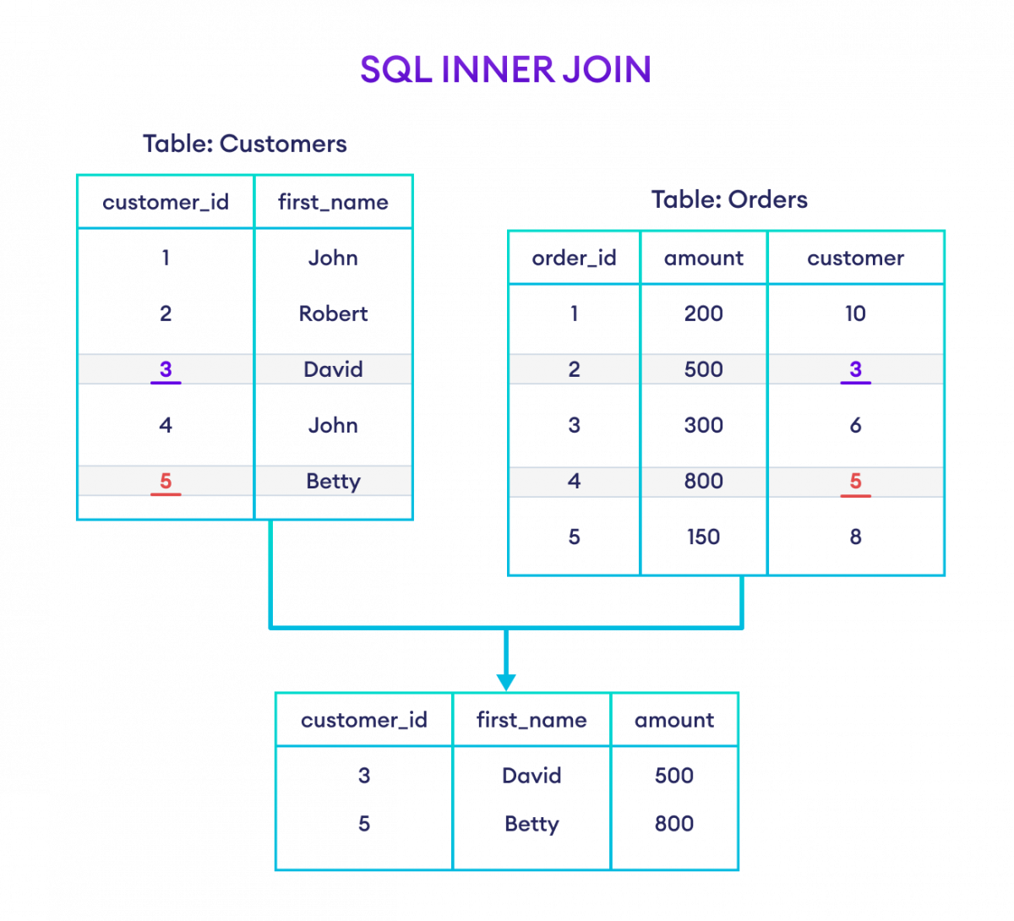
INNER JOIN: The INNER JOIN operation returns rows from both tables that satisfy the join condition. It only includes rows where there is a match between the columns in both tables.
For Example:
SELECT Customers.customer_id, Customers.first_name, Orders.amount
FROM Customers
INNER JOIN Orders
ON Customers.customer_id = Orders.customer;

Slide 24
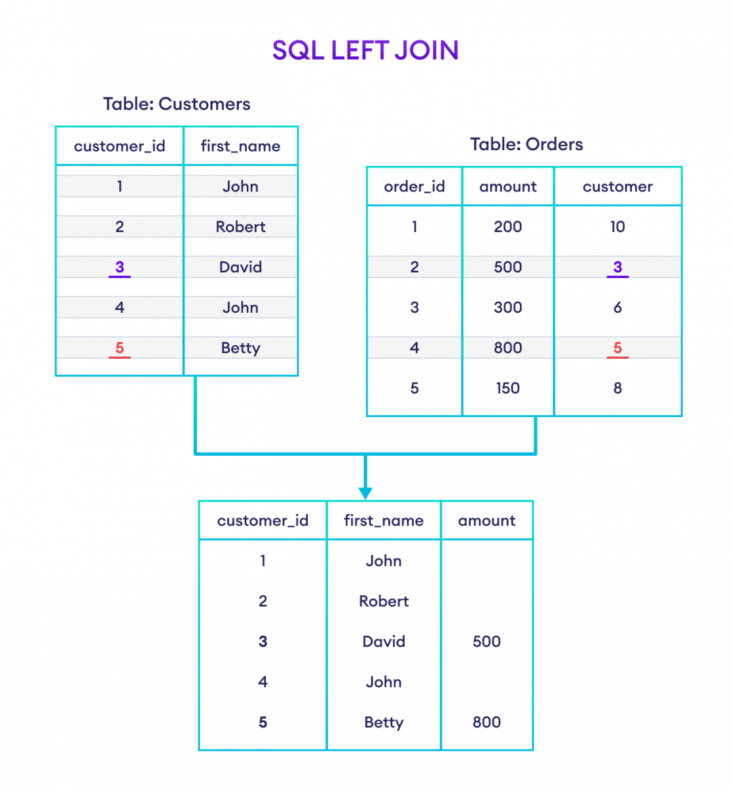
LEFT JOIN :The LEFT JOIN operation returns all rows from the left table (table1), and the matched rows from the right table (table2). If there is no match, NULL values are included for the columns from the right table.
For Example:
SELECT Customers.customer_id, Customers.first_name, Orders.amount
FROM Customers
LEFT JOIN Orders
ON Customers.customer_id = Orders.customer;

Slide 25
RIGHT JOIN :The RIGHT JOIN operation returns all rows from the right table (table2), and the matched rows from the left table (table1). If there is no match, NULL values are included for the columns from the left table.
For Example:
SELECT Customers.customer_id, Customers.first_name, Orders.amount
FROM Customers
LEFT JOIN Orders
ON Customers.customer_id = Orders.customer;

Slide 26
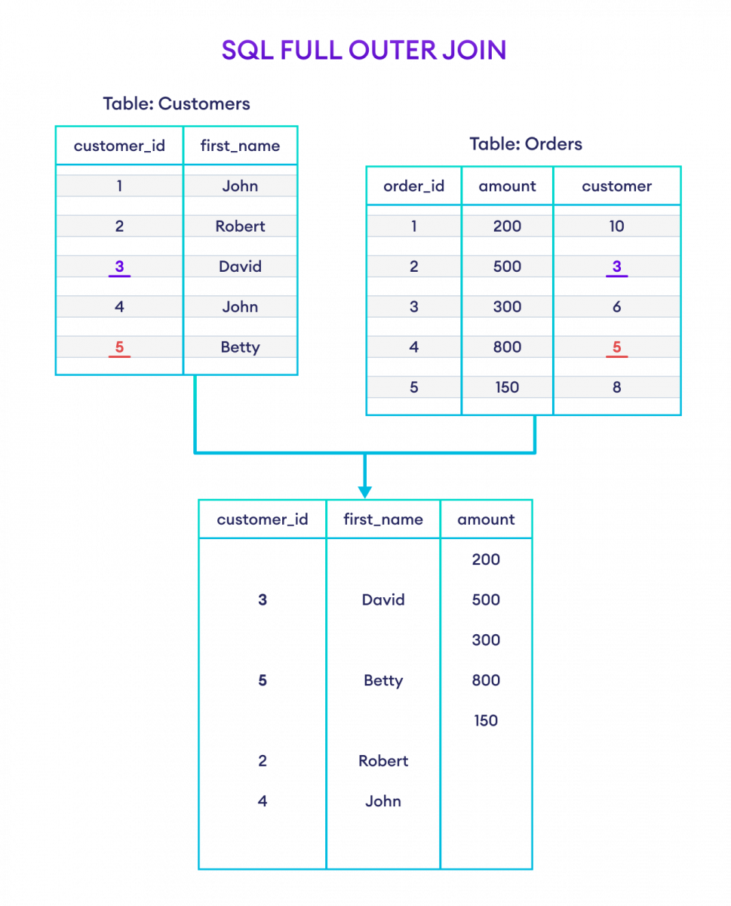
FULL OUTER JOIN: The FULL OUTER JOIN operation returns all rows from both tables, matching them where possible. If there is no match, NULL values are included for the columns from the table without a matching row.
For Example:
SELECT Customers.customer_id, Customers.first_name, Orders.amount
FROM Customers
FULL OUTER JOIN Orders
ON Customers.customer_id = Orders.customer;

Slide 27
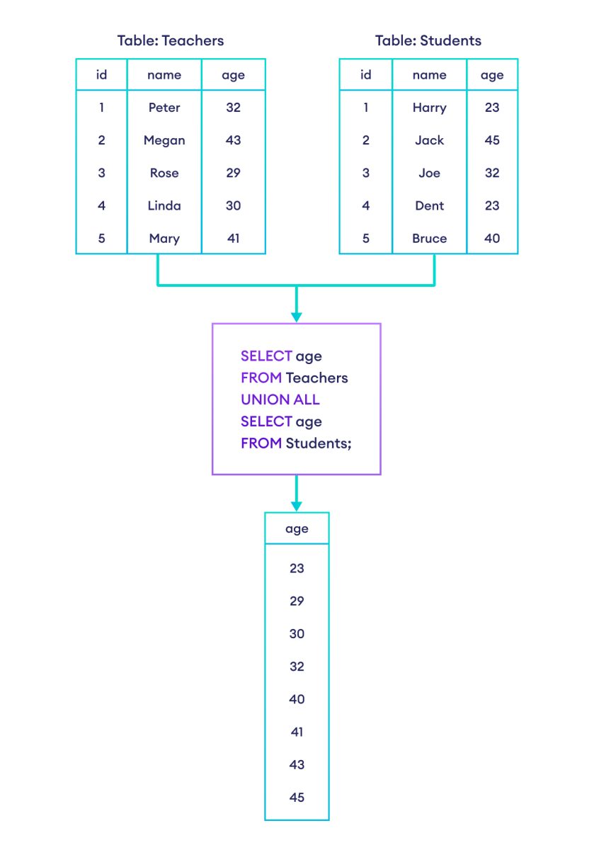
UNION: The UNION operator is used to combine the results of two or more SELECT statements into a single result set. It removes duplicate rows by default.
For Example:

Slide 28
SQL operators:
Arithmetic operators
Bitwise operators
Comparison operators
Logical operators

Slide 29
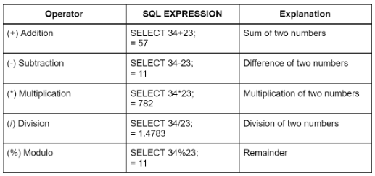
Arithmetic Operators: These operators are used to perform mathematical operations on numeric values. Common arithmetic operators include addition (+), subtraction (-), multiplication (*), division (/), and modulus (%), among others.

Slide 30
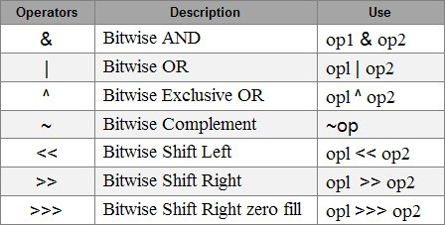
Bitwise Operators: Bitwise operators operate on the individual bits of binary numbers. They are used to perform bitwise operations such as AND, OR, XOR, complement, left shift, and right shift. These operators are often used in low-level programming for tasks involving binary manipulation.

Slide 31
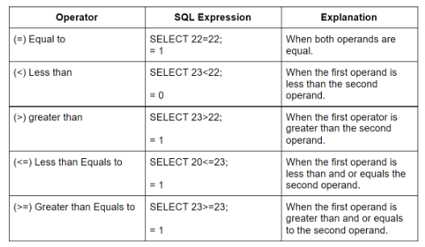
Comparison Operators: Comparison operators are used to compare two values and determine their relationship. Common comparison operators include equal to (==), not equal to (!=), greater than (>), less than (<), greater than or equal to (>=), and less than or equal to (<=). These operators return a Boolean value (true or false) based on the comparison result.

Slide 32
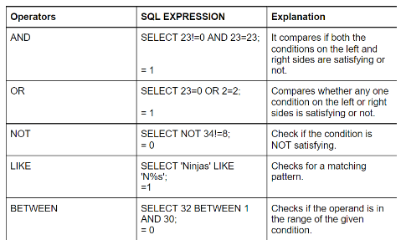
Logical Operators: Logical operators are used to combine or modify Boolean expressions. Common logical operators include AND (&&), OR (||), and NOT (!). They are typically used to create complex conditions by combining simpler conditions.

Slide 33
SQL functions:
COUNT()
AVG()
SUM()
MIN()
MAX()
ROUND()
NOW()

Slide 34
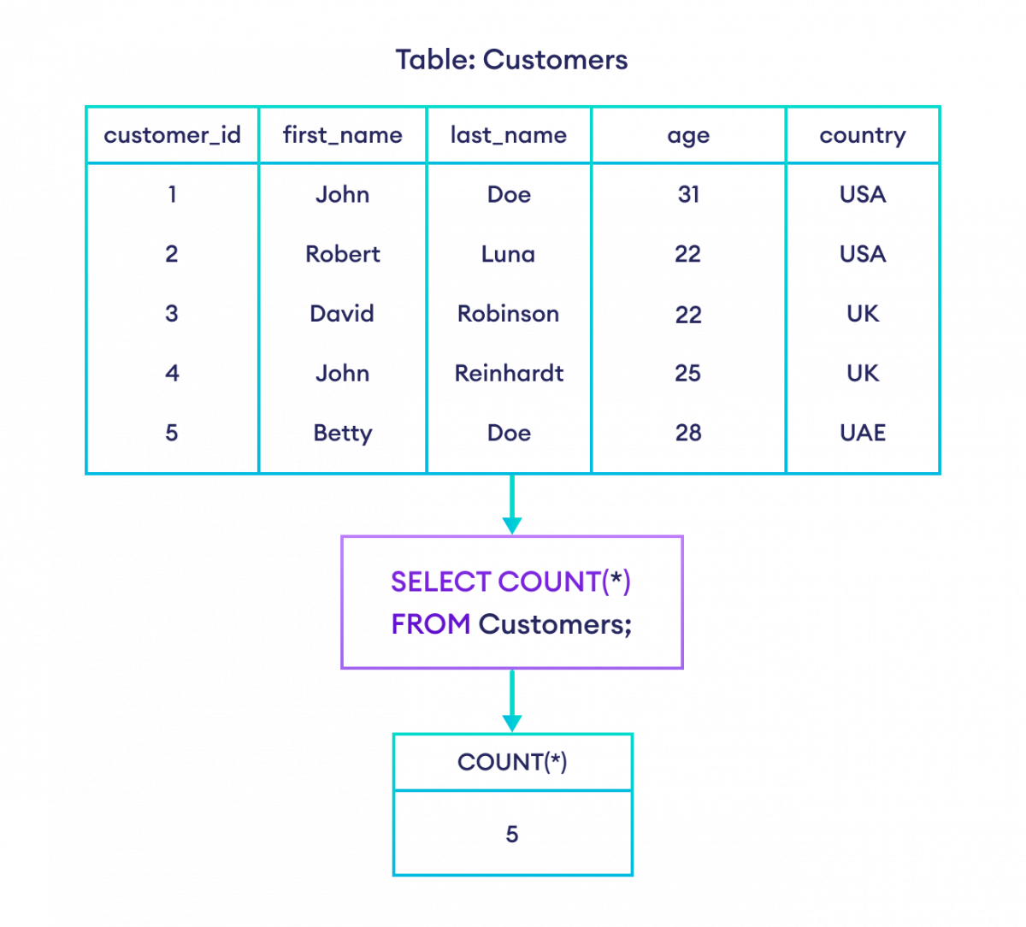
COUNT(): This function is used to count the number of rows returned by a query. It can be used with or without specifying a column name. When used without a column name, it counts all rows; when used with a column name, it counts the number of non-NULL values in that column.

Slide 35
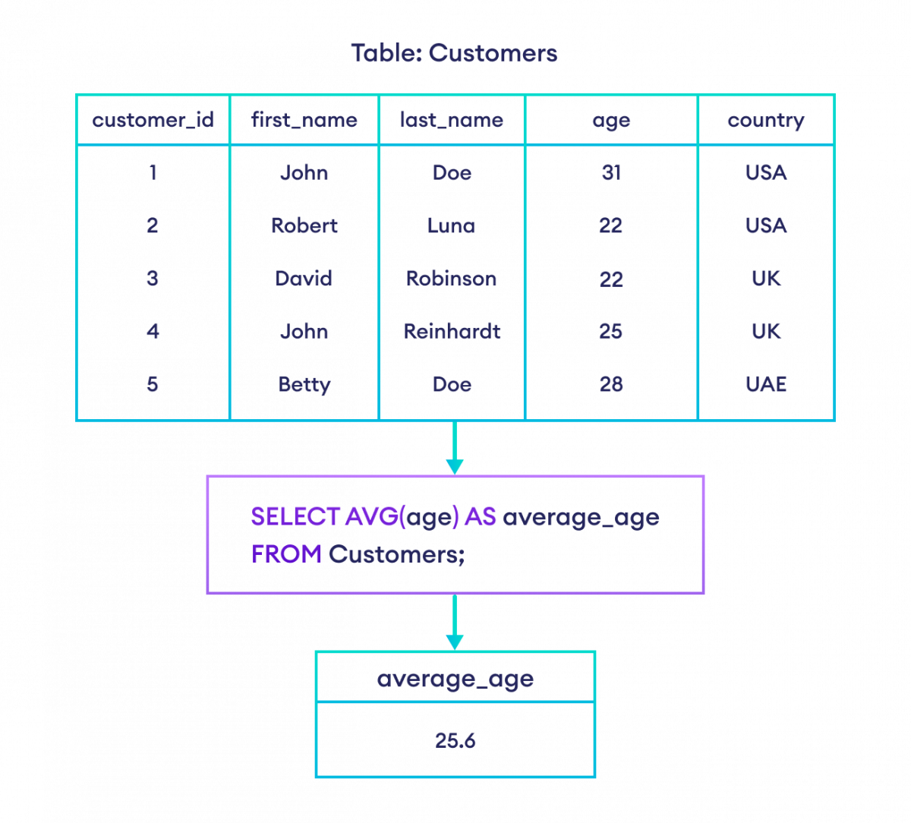
AVG(): This function calculates the average value of a numeric column in a set of rows returned by a query.

Slide 36
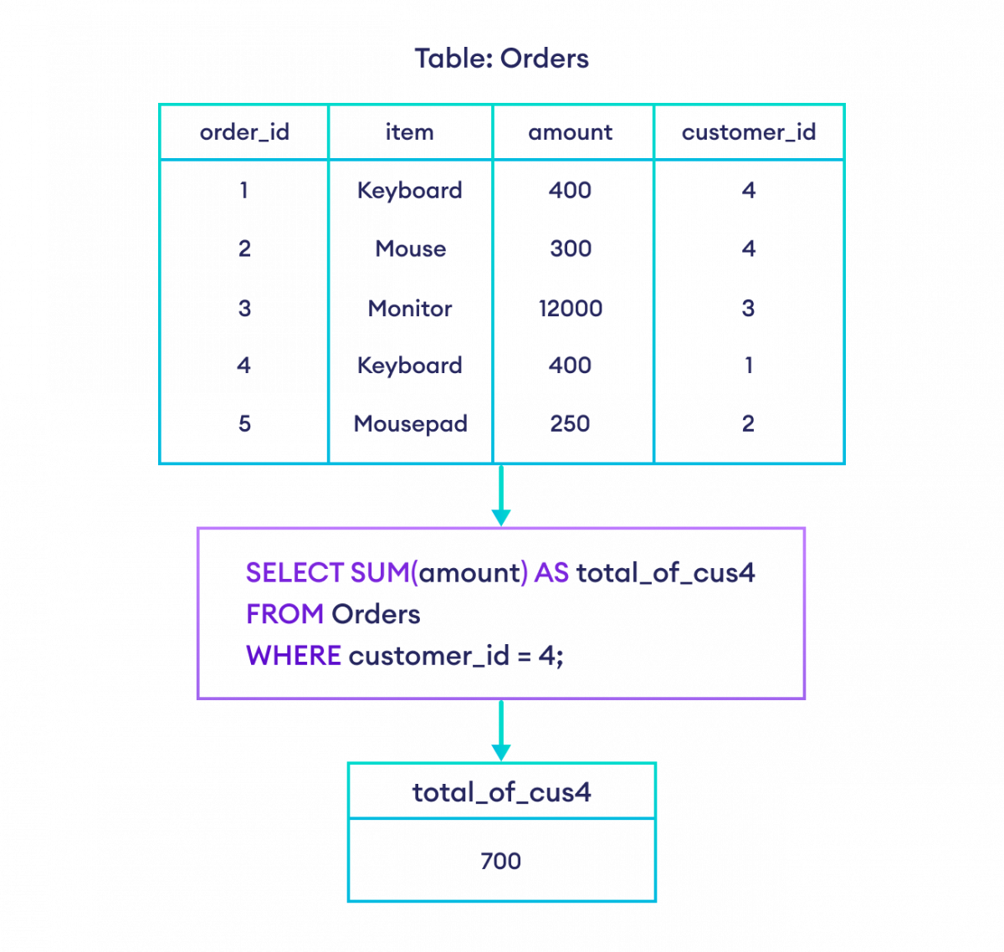
SUM(): This function calculates the sum of values in a numeric column in a set of rows returned by a query.

Slide 37
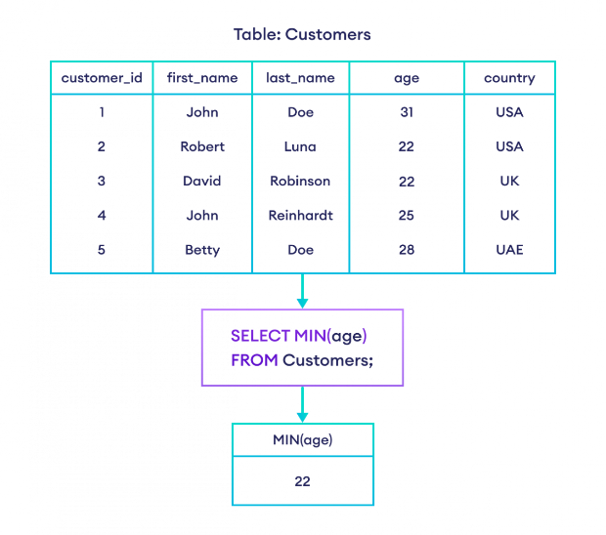
MIN(): This function returns the smallest value in a column among the set of rows returned by a query.

Slide 38
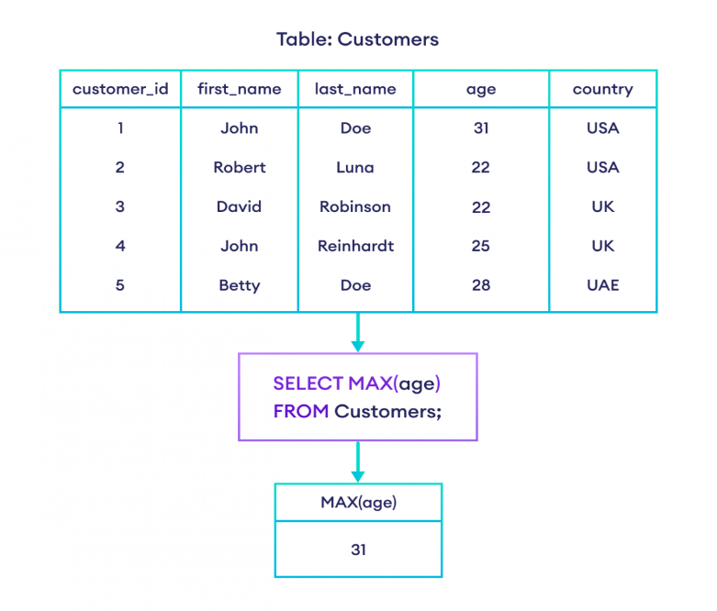
MAX(): This function returns the largest value in a column among the set of rows returned by a query.

Slide 39
ROUND(): This function is used to round a numeric value to a specified number of decimal places.
Eg. SELECT ProductName, Price, ROUND(Price, 0) AS RoundedPrice
FROM Products;
NOW(): This function returns the current date and time according to the system clock of the database server.
Eg. SELECT NOW();

Slide 40
SQL stored procedures:
1.CREATE PROCEDURE: The CREATE PROCEDURE statement is used to define a new stored procedure in the database. A stored procedure is a named collection of SQL statements that can be stored in the database and executed later as a single unit. It can accept input parameters, perform operations, and return results.
For Example:CREATE PROCEDURE procedure_name
AS
BEGIN
-- SQL statements
END;
2.EXEC : The EXEC command is used to execute a stored procedure in the database. It allows you to invoke a stored procedure and optionally pass input parameters to it.
For Example:EXEC procedure_name;

Slide 41
TRIGGER
A trigger is a database object that automatically executes a specified set of SQL statements in response to certain events occurring in a database.
These events can include INSERT, UPDATE, DELETE operations on tables, or even DDL (Data Definition Language) statements like CREATE, ALTER, DROP.
Triggers are used to enforce business rules, maintain data integrity, and automate database tasks.
For Example:CREATE TRIGGER trigger_name
(AFTER | BEFORE) (INSERT | UPDATE | DELETE)
ON table_name FOR EACH ROW
BEGIN
--variable declarations
--trigger code
END;

